Slide 1



INVESTIGATION OF INTENSITY & FREQUENCY OF HEATWAVES OVER GUJARAT REGION
Guided By:
Dr. Charu Singh (Scientist/Engineer SF)
Marine and Atmospheric Department
IIRS-ISRO, Dehradun
Presented by:
Smit Bhuva
Viraj Hirpara

Slide 2
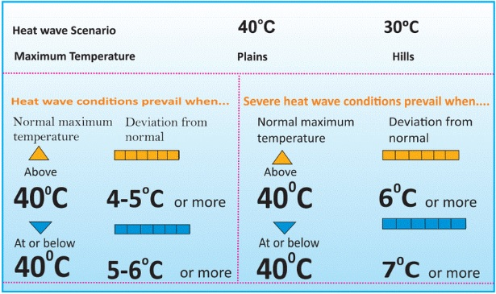
What is heat wave and effect ?
A condition of air temperature which become fatal to human body when exposed.
The world Meteorological organization, defines a heat wave as 5 or more consecutive days of prolonged heat in which the daily maximum temperature is higher than the average maximum temperature by 5º c or more.
Effect on different categories like agriculture sector, Human and animal health and infrastructure.

Slide 3
Objectives :
To find Heat index and understand the characteristics of extreme events – duration, frequency and intensity.
To Analysis the Pattern and Trend for 21 years from 2003 to 2023 data over Gujarat region.

Slide 4
Methodology
Data Download
LST Data From MODIS Via GEE
Data Preprocessing
Cleaning and Organizing the data
Analysis
Heat Index, Anomaly
Histogram

Slide 5
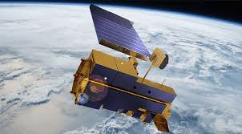
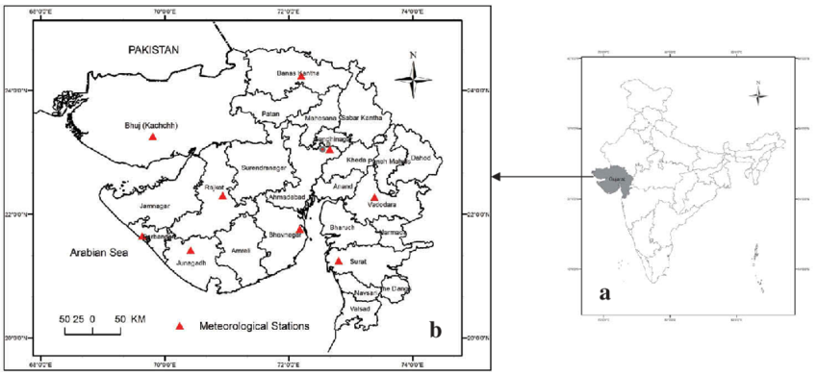
Data Set :
MODIS : Moderate – Resolution Imaging Spectroradiometer .
First Modis was launched on board in form of Terra satellite in December 1999 and the second was launched on Aqua in may 2002.
Monitors 36 spectral bands between 0.4 µm and 14.4 µm.
Images entire earth every 1-2 days at 1 km Resolution.
Study area :

Slide 6
Continue…
We derived Land Surface Temperature from MODIS Terra LST and Emissivity daily global 1k data set using Google Earth Engine.
This dataset offers measurements at a resolution of 1 km which can be accessed by Landset Satellite as well as GEE.
The Data is of Gujarat State at district level and for 21 years from 2003 to 2023 for the months of March, April and May each year.

Slide 7
Analysis
Temperature extreme events can be identify using Heat Index, Anomaly, Percentile and Histogram Analysis.
Heat Index(HI) = (Daily Mean Temp.(Td) – Long Term Mean of Td)
Standard Deviation of Long Term Mean
Anomaly = Daily Mean Temp.(Td) – Long Term Mean of Td

Slide 8
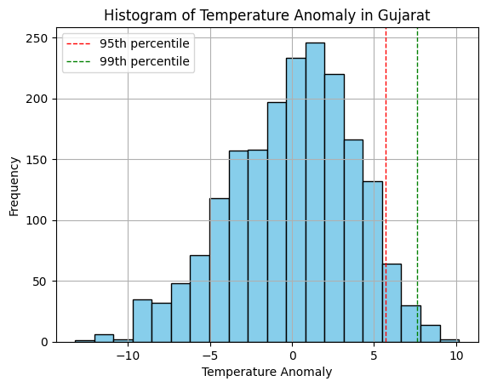
Histogram of Temperature Anomaly in Gujarat
This histogram shows frequency of particular anomaly value over Gujarat Region.
We can say that when anomaly goes aver value of 95 percentile there is high chance of heat wave happening there .

Slide 9
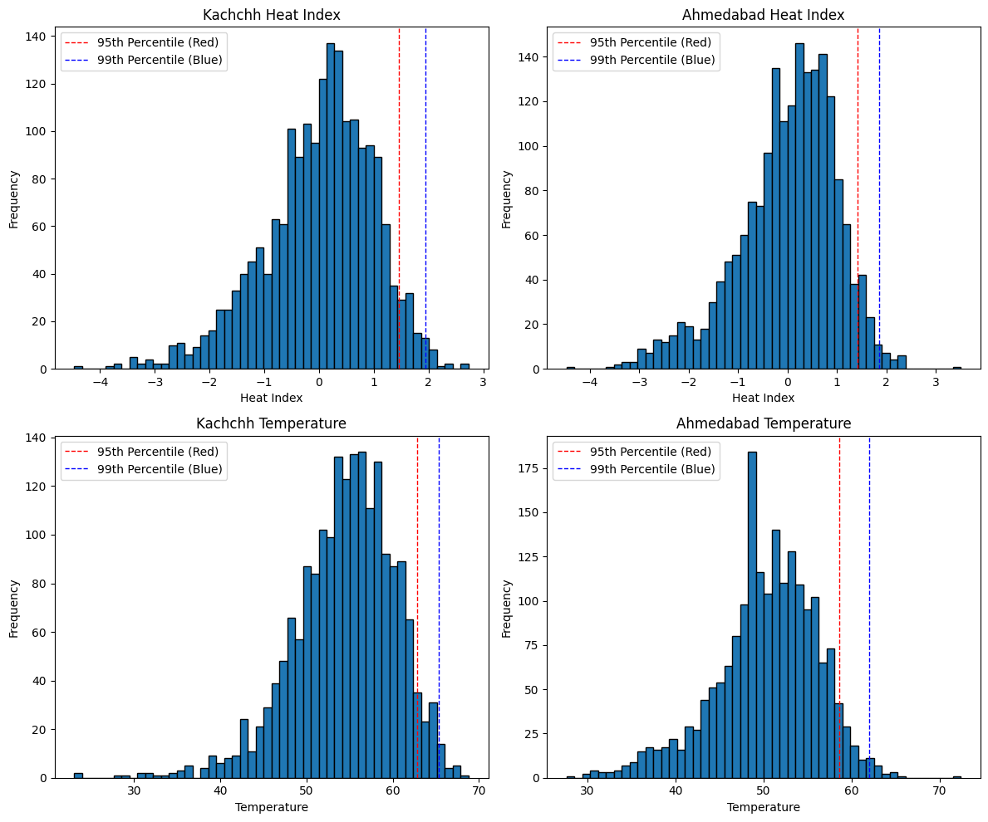
Analysis

Slide 10
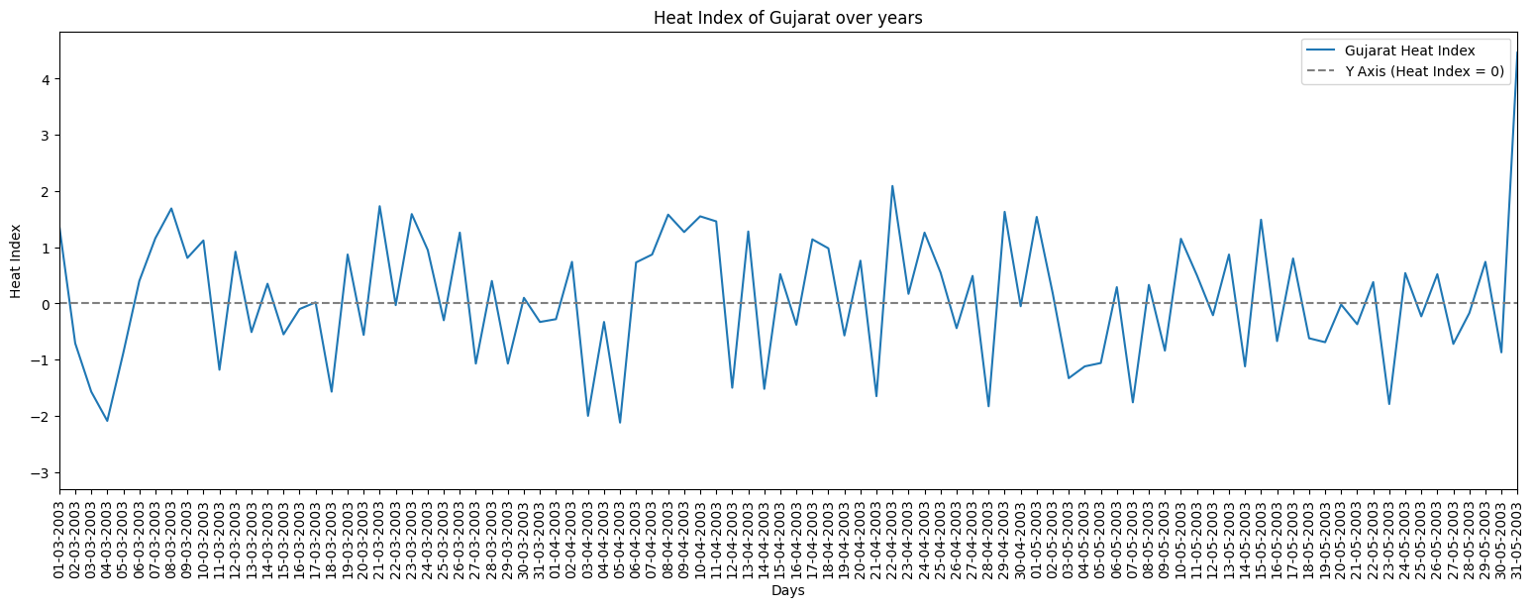
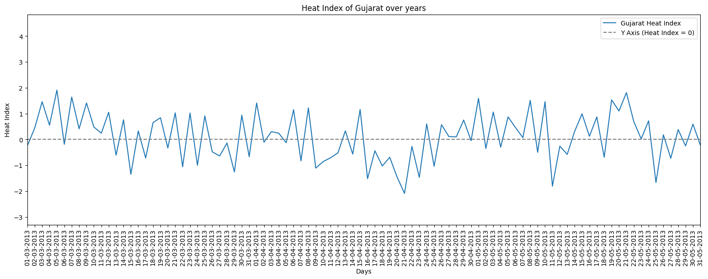
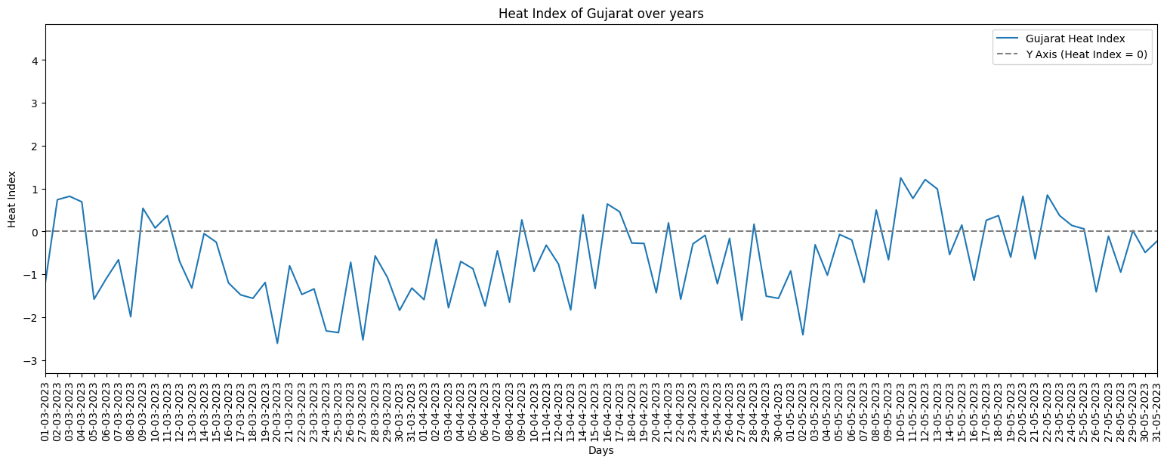

Slide 11
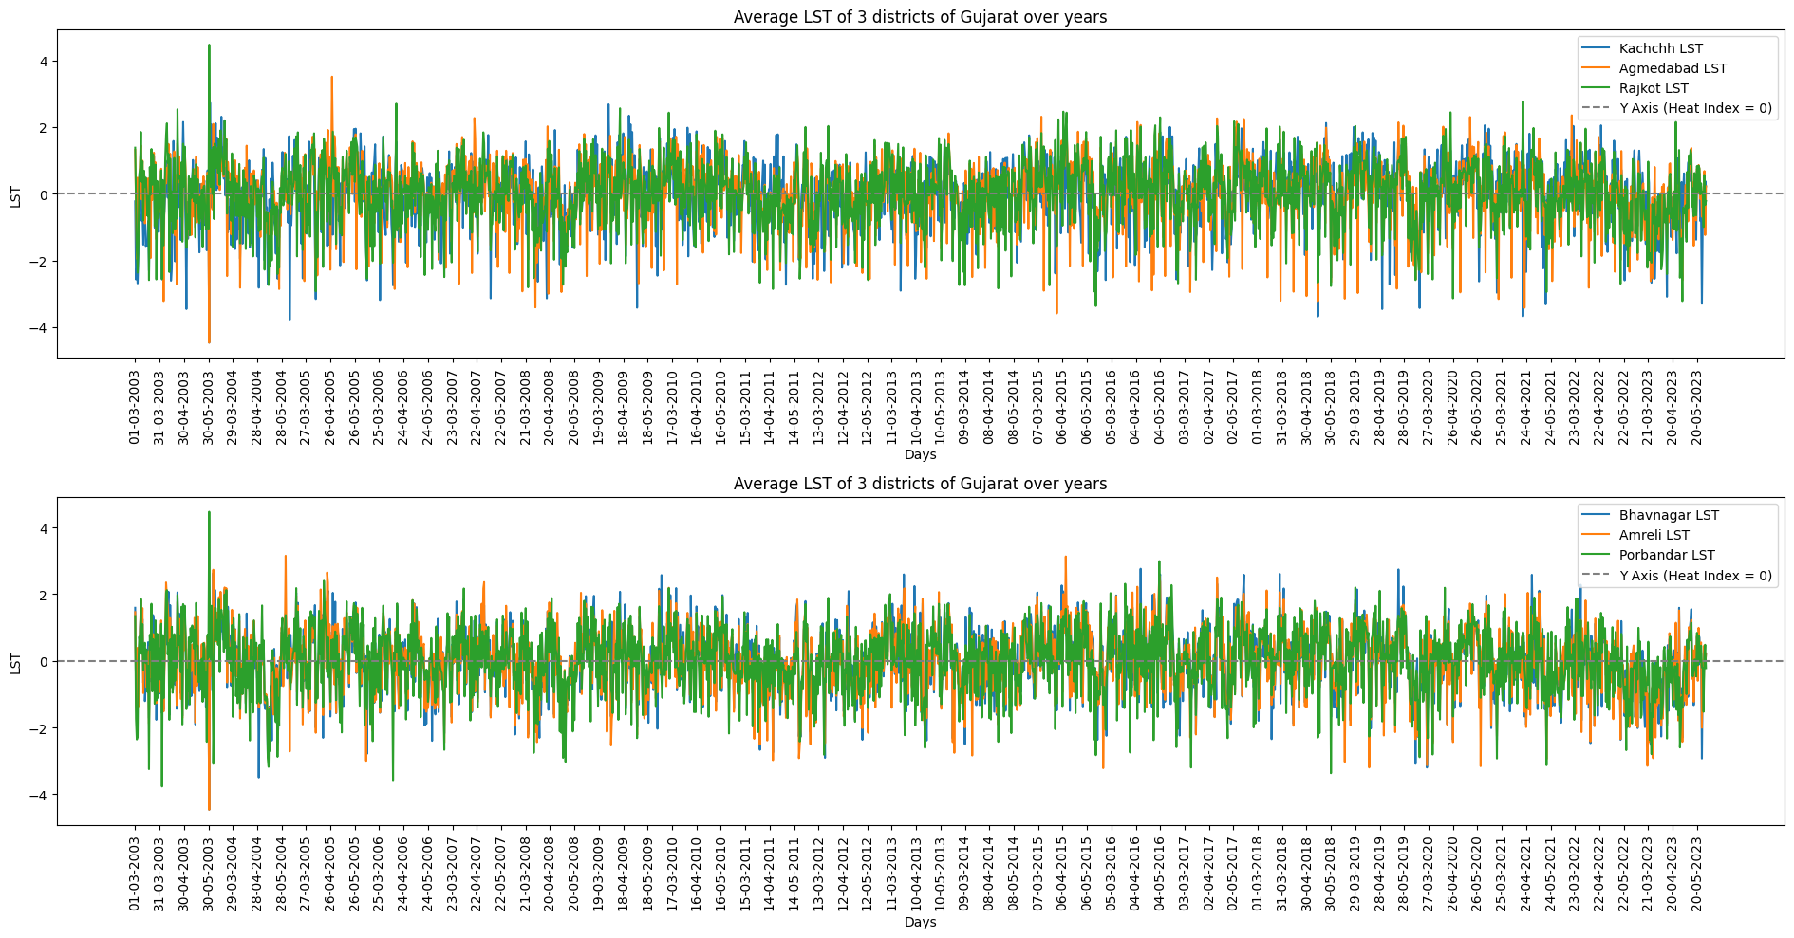
Analysis

Slide 12
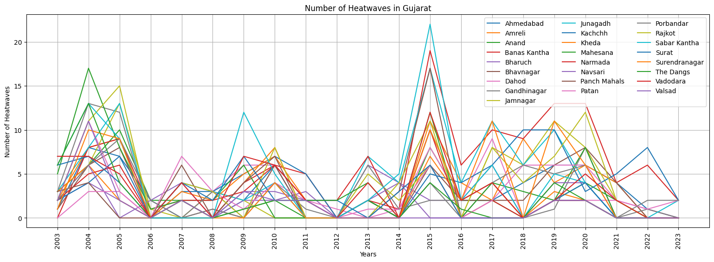
Analysis

Slide 13
Conclusion
Although there is no linear trend in temperature over the years but we can identify that majority of heat wave events occurred in April month of every year.
During those 21 years maximum heat wave events are found in the years of 2004, 2005 and 2015.
We found that all the years with high intensity and frequency of Heatwaves also are El-NINO years.
El-NINO causes depletion in total annual rainfall in compared to average annual rainfall of that area which is also a cause of occurance heatwaves in that area.

Slide 14
Limitations
We could not find 2m Air Temperature Data at daily scale in time limit, So we used LST instead of 2m Air Temperature because generally LST is 6 to 8 Degree higher than 2m Air Temperature and both have similar characteristics .

Slide 15
Future Scope
By working on this project, we understood the workflow and data collection method, hence we can work on actual 2m Air temperature
In future, there may be a chance of developing such scenario where analysis of heat wave analysis as it will impact on crop health at considerable amount.
Suggestion: We strongly recommend you to use 2m Air Temperature instead of LST, however LST have similar properties to the 2m Air Temp., It is not accurate to use it.

Slide 16
Thank You…

